Slide 1
s
O
O
O

Slide 2
s
O
O
O

Slide 3
J
O
O
O
O

Slide 4
J
O
O
O
O

Slide 5
J
O
O
O
O
The Journal of Cutaneous Oncology
Official publication of the Society of Cutaneous Oncology

Slide 6
s
O
O
O

Slide 7
J
O
O
O
The Journal of Cutaneous Oncology
Official publication of the Society of Cutaneous Oncology

Slide 8


The Journal of Cutaneous Oncology
Official publication of the Society of Cutaneous Oncology

Slide 9


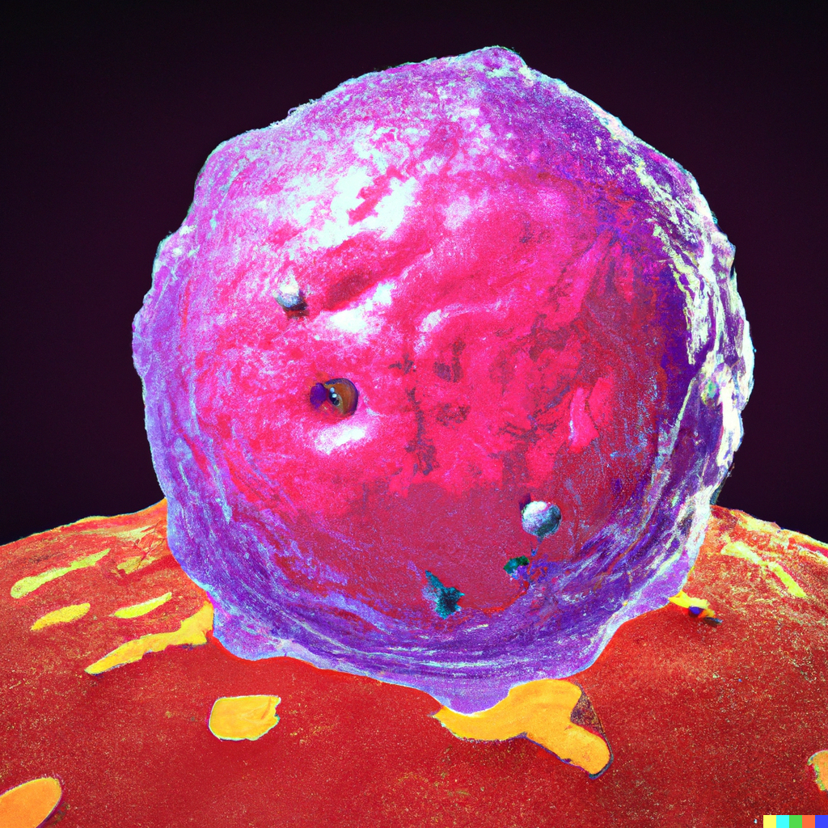
Volume 1, Issue 1
The Journal of Cutaneous Oncology
Official publication of , the Society of Cutaneous Oncology

Slide 10
Volume 1, Issue 1
The Journal of Cutaneous Oncology
Official publication of , the Society of Cutaneous Oncology

Slide 11
Volume 1, Issue 1
The Journal of Cutaneous Oncology
Official publication of the Society of Cutaneous Oncology

Slide 12
Volume 1, Issue 1
The Journal of Cutaneous Oncology
Official publication of the Society of Cutaneous Oncology

Slide 13


Slide 15
Volume 1, Issue 1
The Journal of Cutaneous Oncology
Official publication of the Society of Cutaneous Oncology

Slide 16

Volume 1, Issue 1
The Journal of Cutaneous Oncology
Official publication of the Society of Cutaneous Oncology

Slide 17
Volume 1, Issue 1
The Journal of Cutaneous Oncology
Official publication of the Society of Cutaneous Oncology

